Slide 1

GUI Elements

Slide 2
Introduction
Graphical user interface elements are those elements used by graphical user interfaces (GUIs) to offer a consistent visual language to represent information stored in computers.
We can click
select
check
Uncheck
these GUI elements using Selenium.

Slide 3
Various GUI Elements
Check boxes
Buttons
Label buttons
Radio buttons
Sliders
Droplists
Text boxes

Slide 4
Identifying Elements
In order to write UI tests with Selenium WebDriver you need to be able to identify web page elements fast and in an accurate way. You don’t want to revisit these selectors very often so you must choose the right selector from the beginning.
There are some browser tools that you can use in order to identify web elements in the DOM easier. These are:
Firebug for Firefox
Google Developer Tools for Chrome
Web Inspector for Safari
You can also create automated website tests for free with LoadFocus.com.

Slide 5
Identifying Elements-2
Selenium WebDriver API supports different possibilities to identify elements: by ID, by CLASS, by NAME, by CSS selector, by XPath, by TAG name. Also you define your custom selector in order to interact with the elements.
It’s always a good practice to assign unique IDs to elements, also names and classes in order to be more usable for automatic UI tests. If that is not possible you’ll need to use advanced or XPath selector to interact with those elements. The most popular selectors are the CSS selectors due to performance and simplicity reasons.
To inspect an element you just have to open the desired web page, right-click the desired element and click on Inspect Element. A new panel will open showing the desired element. Also you can inspect other elements by clicking on the cursor in the top left side of the Developer Tools or Firebug panels and hovering page elements.

Slide 6
Summary of Locating Elements
Variation | Description | Sample
By.className | finds elements based on the value of the "class" attribute | findElement(By.className("someClassName"))
By.cssSelector | finds elements based on the driver's underlying CSS Selector engine | findElement(By.cssSelector("input#email"))
By.id | locates elements by the value of their "id" attribute | findElement(By.id("someId"))
By.linkText | finds a link element by the exact text it displays | findElement(By.linkText("REGISTRATION"))
By.name | locates elements by the value of the "name" attribute | findElement(By.name("someName"))
By.partialLinkText | locates elements that contain the given link text | findElement(By.partialLinkText("REG"))
By.tagName | locates elements by their tag name | findElement(By.tagName("div"))
By.xpath | locates elements via XPath | findElement(By.xpath("//html/body/div/table/tbody/tr/td[2]/table/tbody/tr[4]/td/table/tbody/tr/td[2]/table/tbody/tr[2]/td[3]/ form/table/tbody/tr[5]"))

Slide 7
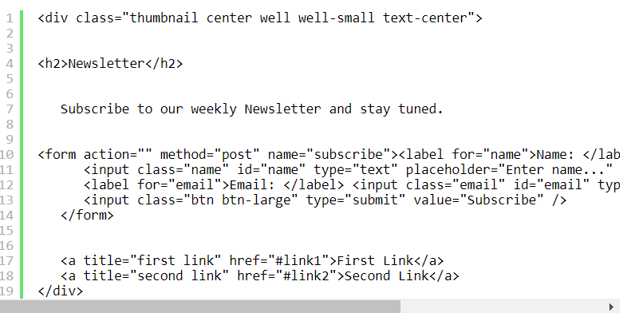
HTML Code Snippet
Let’s get a HTML snippet code and see how can we use these Selenium WebDriver selectors in order to identify the desired elements:

Slide 8
Getting WebElements
By fullText:
WebElement firstLink = driver.findElement(By.linkText("First Link"));
By PartialText:
WebElement firstLink = driver.findElement(By.partialLinkText("First"));
By tagName
WebElement subscribeButton = driver.findElement(By.tagName("button"));

Slide 9
Getting WebElements
By CSS Selectors:
WebElement emailInputField =driver.findElement(By.cssSelector("form input#email"));
or
WebElement emailInputField =driver.findElement(By.cssSelector("input.email"));
or
WebElement emailField =driver.findElement(By.cssSelector("input[type='submit'][value='Subscribe']"));

Slide 10
Getting WebElements
Performing partial match on attribute values:
^= as in input[id^='email'] means Starting with.
$= as in input[id$='name'] means Ending with.
*= as in Input[id*='userName'] means Containing.

Slide 11
Getting WebElements
By Xpath
Absolute path
WebElement userName =driver.findElement(By.xpath("html/body/div/form/input"));
Relative path
WebElement email = driver.findElement(By.xpath("//input"));
Finding elements using index
WebElement email =driver.findElement(By.xpath("//input[3]"));
Finding elements using attributes values with Xpath
WebElement logo =driver.findElement(By.xpath("img[@alt='logo']"));

Slide 12
Getting WebElements
XPATH
starts-with():
input[starts-with(@id,'input')]
Starting with:
ends-with()
input[ends-with(@id,'_field')]
Ending with:
contains()
input[contains(@id,'field')]

Slide 13
Thanks

